Slide 1
The Elements of Design

Slide 2
Elements of Design
Six integral components in the creation of a design
Line
Shapes & Form
Color
Light & Shadow
Space
Texture

Slide 3
Line
Can be straight, curved, horizontal, vertical, or diagonal
Produces a sense of movement
Curved
Graceful flow
Horizontal
Increases length
Vertical
Increases height
Diagonal
Shows a transition
Can be thick,
thin
or broken

Slide 4
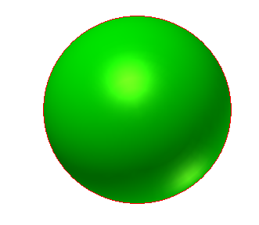
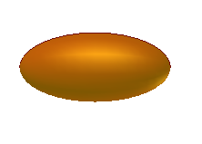
Shapes and Forms
The shape is the 2-dimensional outline of an object; forms are 3-dimensional versions of the shape.
Some examples of specific shapes and forms are:
Squares
Rectangles
Circles
Triangles
Ovals

Slide 5
Color
Provides definition, interest, variety, and attracts attention
Each color may evoke a sense of different feelings, such as
Red Warm
Yellow Attention
Green Lessen tension
Blue Cool or formal
Violet Mystery

Slide 6
Light and Shadow
By using various combinations of light & shadow, you can create a sense of depth.

Slide 7
Space
By incorporating the use of space in your design, you can enlarge or reduce the visual space.
Empty Space
Lots of Space
Out of Space

Slide 8
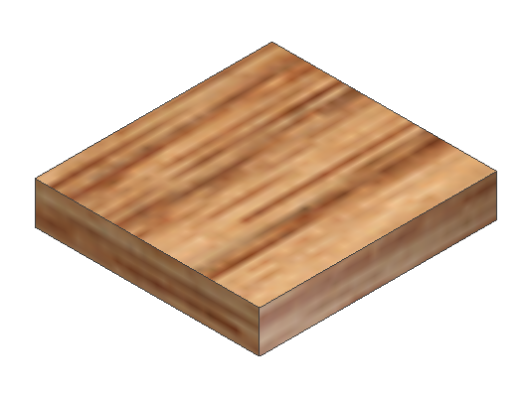
Texture
The use of various patterns combined with appropriate colors can visually simulate various materials.

